Slide 1
UI Unlimited -
Things you can do
with the
New
Cincom Smalltalk UI
Notes:
1
Hi – Dirk Verleysen – Software Engineer OST
Lead Developer Modeling & Mapping Tool
Show some of the features of the Native Windows Cincom Smalltalk UI

Slide 2

Notes:
2
ObjectStudio centric
In the future it might be usable by VW Users

Slide 3
Related Talks
How and Where in Glorp Tutorial – Niall Ross
Pursuing Performance in Store – Tom Robinson
Cincom Smalltalk New Native GUI – Andreas Hiltner
Cincom Smalltalk Roadmap – Arden Thomas
Notes:
Related Talks
Interesting for CST users en I want to specially mention the talk of Andreas Hiltner of tomorrow afternoon which is directly related to this talk and will be more about the insides of the project.
Project got started around July last year and Andreas did a lightning talk about it in Gent last year.

Slide 4
Intention and Goals
Modernize the UI Controls / Widgets
Eliminate Primitives and use DLLCC
Easy to Maintain and Extend
Notes:
You’ll see this slide tomorrow as well and i stole it but it’s too important.
The current OST API is old, written in C, hard to maintain and extend.

Slide 5
Questions - Usability
How does the API work?
Works for a regular business application?
Performance?
Extend the API?
Notes:
Limits of the UI and we needed to find out.
Hobby – Business - Whisky

Slide 6
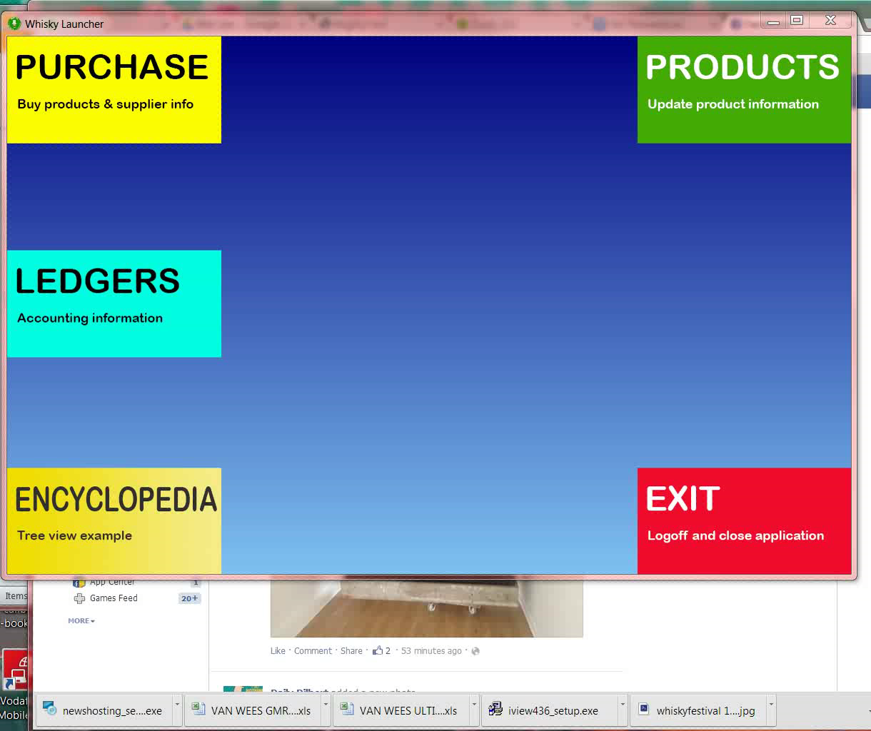
Demo 1

Slide 7
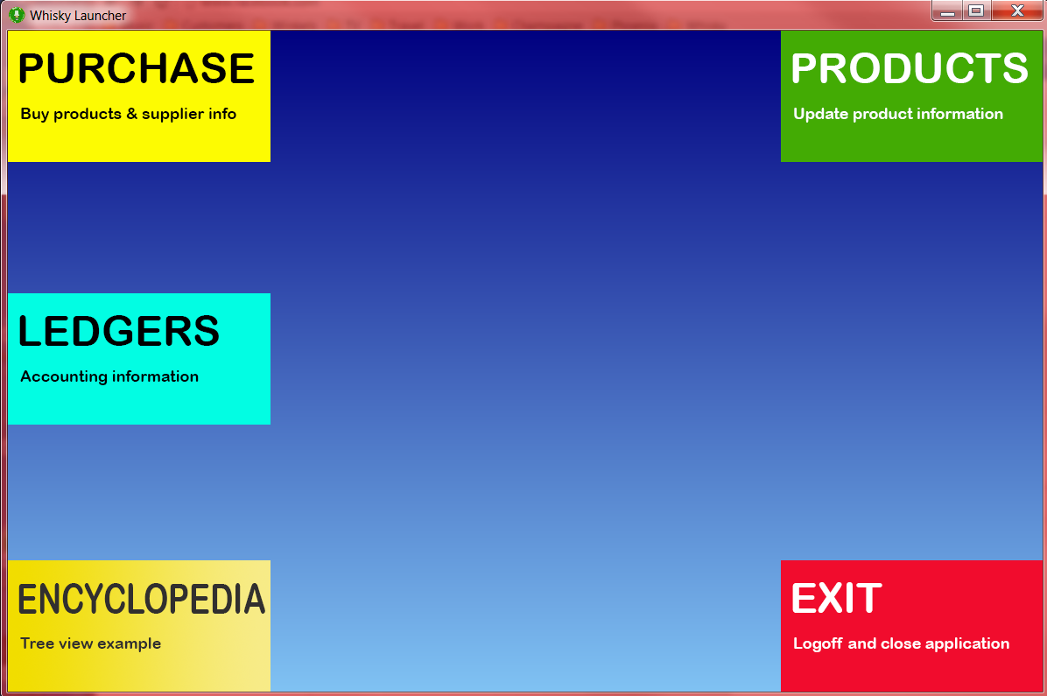
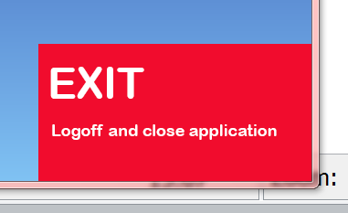
Launcher
Notes:
Gradient background – drawn by windows
UIOwnerDrawButton with png’s.
OLD -> bmp background
Buttons are push buttons with bitmaps on them
HOTFRAME

Slide 8
Building the window
15@15
WndBrush newColor: RGBColor blue
self mainWindow: UIView new.
self mainWindow
position: self position;
extent: self extent;
text: self title;
backgroundBrush: self defaultBackgroundBrush;
gdipBackgroundBrush: self defaultGdipBackgroundBrush;
create;
setDefaultEvents;
setDefaultStyle;
setIconTo: self icon;
redisplay
1200@800
‘Whisky Launcher’
GdipLinearGradientBrush
rect: (0 @ 0 extent: self extent)
color1: ARGBColor navy
color2: ARGBColor lightSkyBlue
mode: #LinearGradientModeVertical
self getIcon: #company using: 'c:\programdata\projects\comp.ico'

Slide 9

Creating Widgets - UIOwnerDrawButton
widget := self
add: #imgProducts
class: UIOwnerDrawButton
rect: #(883 0 300 150)
options: ((IdentityDictionary new)
at: #theme put: UIThemeData new;
yourself)
form: self mainWindow.
widget filename: ‘c:\...\productTile.png’.
widget setDefaultEvents
Notes:
Default events are the hover of the button - hotframe

Slide 10

Creating Widgets - UIEdit
widget := UIEdit
newRect: #(650 5 50 30)
options: self optionsDictionary
text: ‘’
form: self tabInfo.
widget
theme: UIThemeData new;
presentation: self productNamePresentation.
widget
create;
setDefaultEvents;
updateWindow.
(IdentityDictionary new)
at: #exStyle put: WS_EX_LTRREADING | WS_EX_RIGHTSCROLLBAR;
at: #style put: WS_CHILD | …;
yourself

Slide 11
UIControl vs UIPresentation
UIPresentation
accessPath
setterPath
formats
decisionBlock
imagePath
align
…
presentation
UIEdit
object
object:
updateWindow
Business Object

Slide 12
UIPresentation - accessPath setterPath
accessPath | setterPath
#name #(name) [:obj | obj name] | nil #name #(name) [:obj :value | obj name: value]
widget presentation accessPath: #name; setterPath: nil

Slide 13
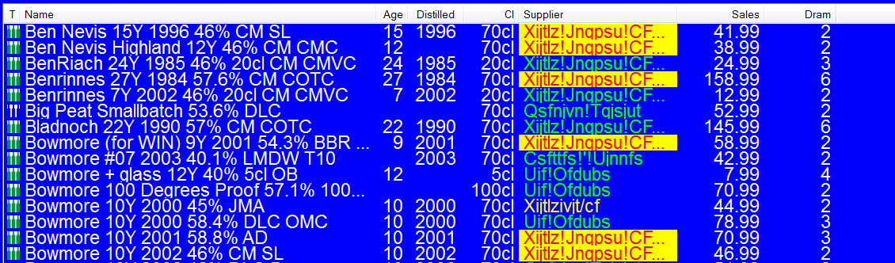
UIPresentation - sortAccessPath
column presentation
accessPath: [:obj | obj volume printString , ‘cl’];
sortAccessPath: [:obj | obj volume];
align: #right

Slide 14
UIPresentation - imagePath
imageList := ImageList new.
imageList
create: 16
y: 16
mask: nil
initial: 4
grow: 4,
imageList
add: SingleMalt loadIcon
….
column presentation
accessPath: [:obj | ‘’];
imagePath: [:obj | obj class iconNumber]

Slide 15
UIPresentation – decisionBlock
column presentation
accessPath: [ :obj | obj findCheapestSupplier
ifNil [‘’]
ifNotNil: [ :supplier | supplier companyName]];
formats: ((IdentityDictionary new)
at: #+ put: (UIControlFormat
font: (Font newArray: #(#FontFace #Arial) #(#PointSize 14)))
textColor: RGBColor green
backgroundColor: RGBColor blue);
at: #= …. ;
at: #- …..;
yourself);
decisionBlock: [:obj | obj available asSymbol]

Slide 16
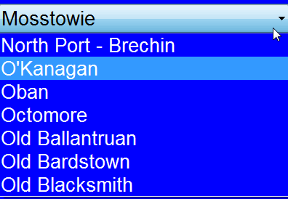
UIPresentation - UIDropDownListBox
Product
Brand
0-*
ddlbBrand
object: self currentProduct;
presentation list: Brand all.
ddlbBrand presentation
accessPath: [:aProduct| aProduct brand]
ddlbBrand presentation
displayValue: [:aBrand | aBrand name]

Slide 17
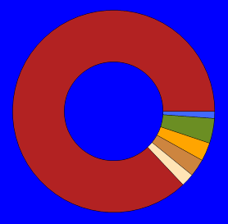
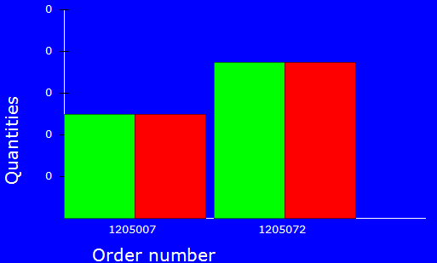
Graphics
Object & Presentation
Extra instance variables for Presentation like dougnutStyle: totalValueBlock: xTicksTextPath yTicksTextPath axisPen axisFont ….
Extra formats like UIBarChartFormat, UIPieChartFormat
Array of accessPath and decisionBlock (BarChart)

Slide 18
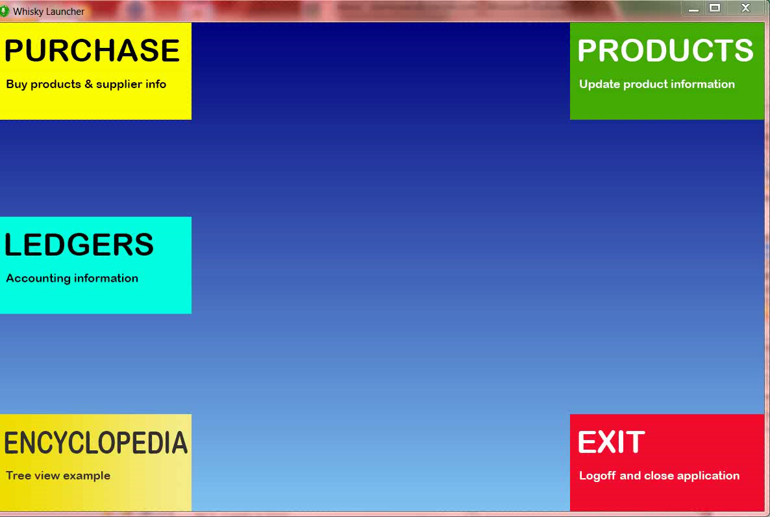
Demo 2

Slide 19
Contact Information
Star Team (Smalltalk Strategic Resources)
  Suzanne Fortman (sfortman@cincom.com)
Cincom Smalltalk Program Director
  Arden Thomas (athomas@cincom.com)
Cincom Smalltalk Product Manager
  Jeremy Jordan (jjordan@cincom.com)
  Cincom Smalltalk Marketing Manager
http://www.cincomsmalltalk.com
Notes:
OSTDEV program

Slide 20

Thanks for listening

